Slide 1
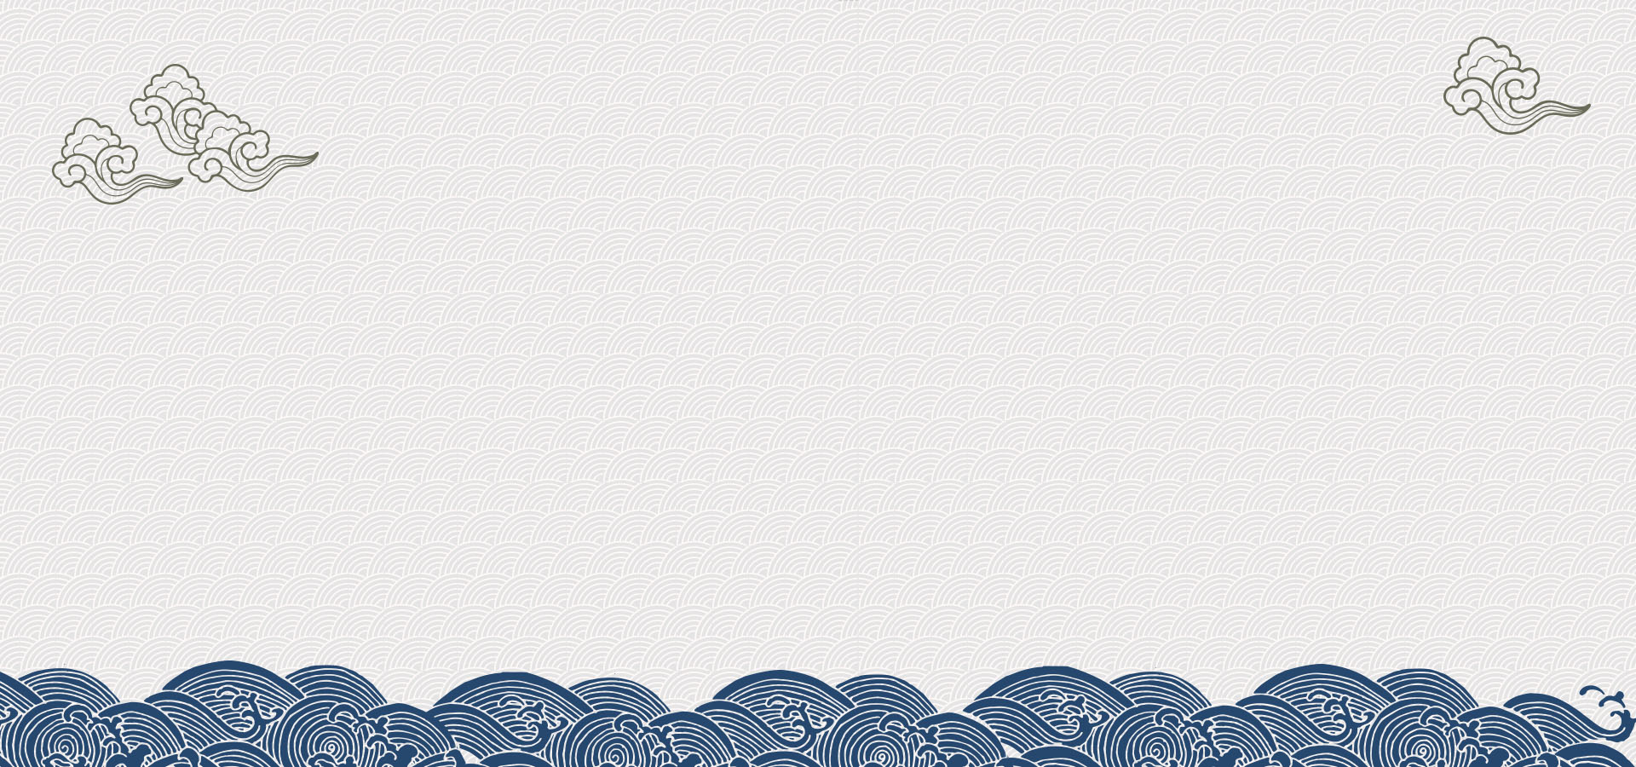
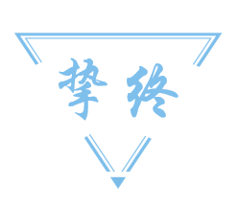
实用科技英语翻译
汇报人：任广轶
时间：2023年5月31日

Slide 2
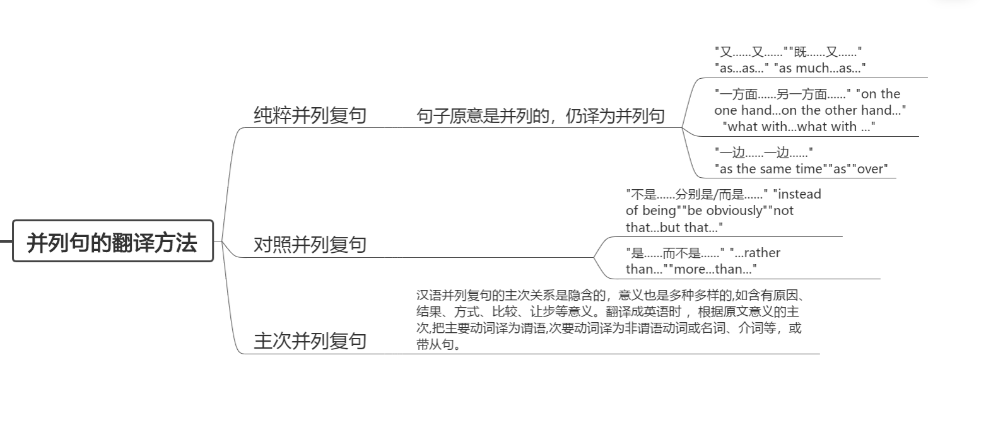

Slide 3
1.3 主次并列复句
汉语并列复句的主次关系是隐含的，意义也是多种多样的,如含有原因、结果、方式、比较、让步等意义。翻译成英语时 ，根据原文意义的主次,把主要动词译为谓语,次要动词译为非谓语动词或名词、介词等，或带从句。

Slide 4
例：
1.电容器由两块金属板组成，两块板用绝缘介质隔开。
（电容器 capacitor 绝缘介质 insulating medium ）
The capacitor consists of two metal plates, separated by an insulating medium.
2.这篇文章研究微波,特别注意无线电定位的问题。
（微波 microwaves）
This article deals with microwaves, with particular attention being paid to radio location.
3.我们用自己动手的方式达到了丰衣足食的目的。
By using our own hands we have attained the objective of ample food and clothing.

Slide 5
How Transistors Changed the World over 75 Years
————晶体管如何在75年内改变世界

Slide 6
晶体管泛指一切以半导体材料为基础的单一元件，晶体管具有检波、整流、放大、开关、稳压、信号调制等多种功能，晶体管可用于各种各样的数字和模拟功能。
打个简单的比喻，我们的大脑由1000亿个称为神经元的细胞组成，这些细胞用于思考和记忆事物。计算机也一样，也有数十亿个名为晶体管的微小脑细胞。
在数字电路领域，电子管和晶体管通俗理解就是可以控制的开关，所以可以实现逻辑运算。在模拟电路领域，电子管和晶体管通俗理解就是放大信号，输入一个微弱的信号可以输出一个放大了很多倍的信号。集成电路的通俗理解就是一个有黑色壳封装的硅片上面有几十亿个晶体管可以实现各种逻辑运算。

Slide 7
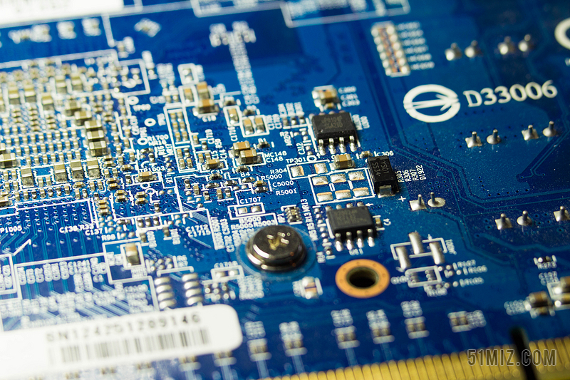
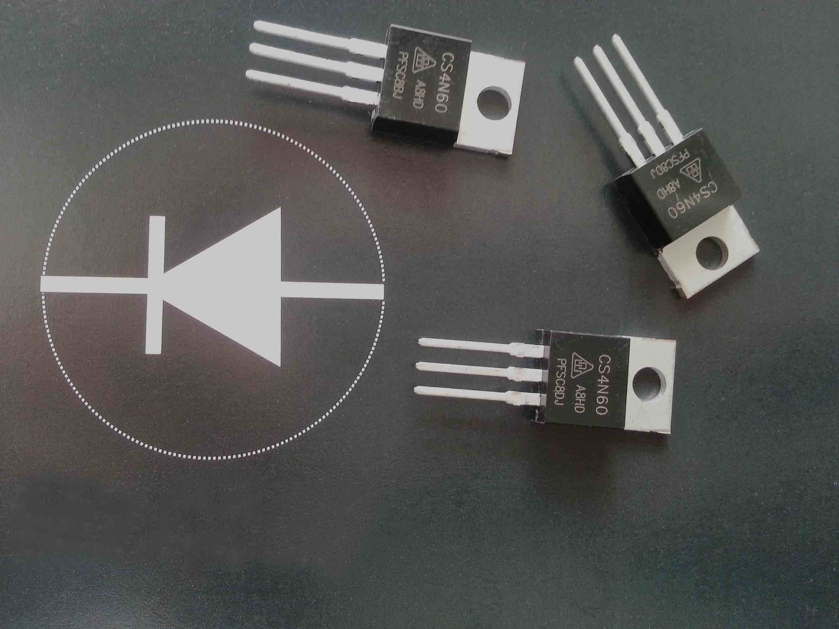
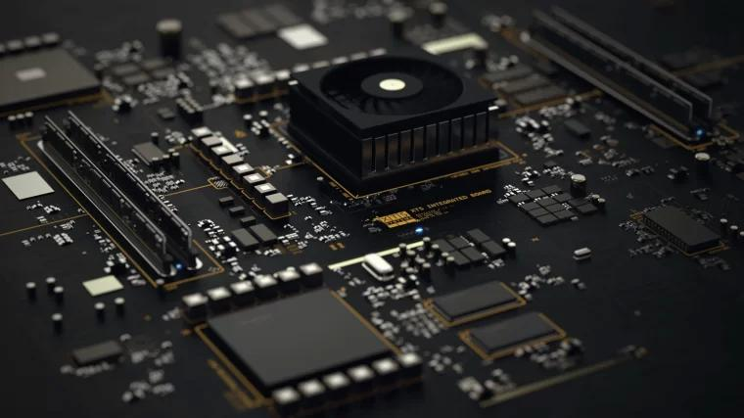

Slide 8
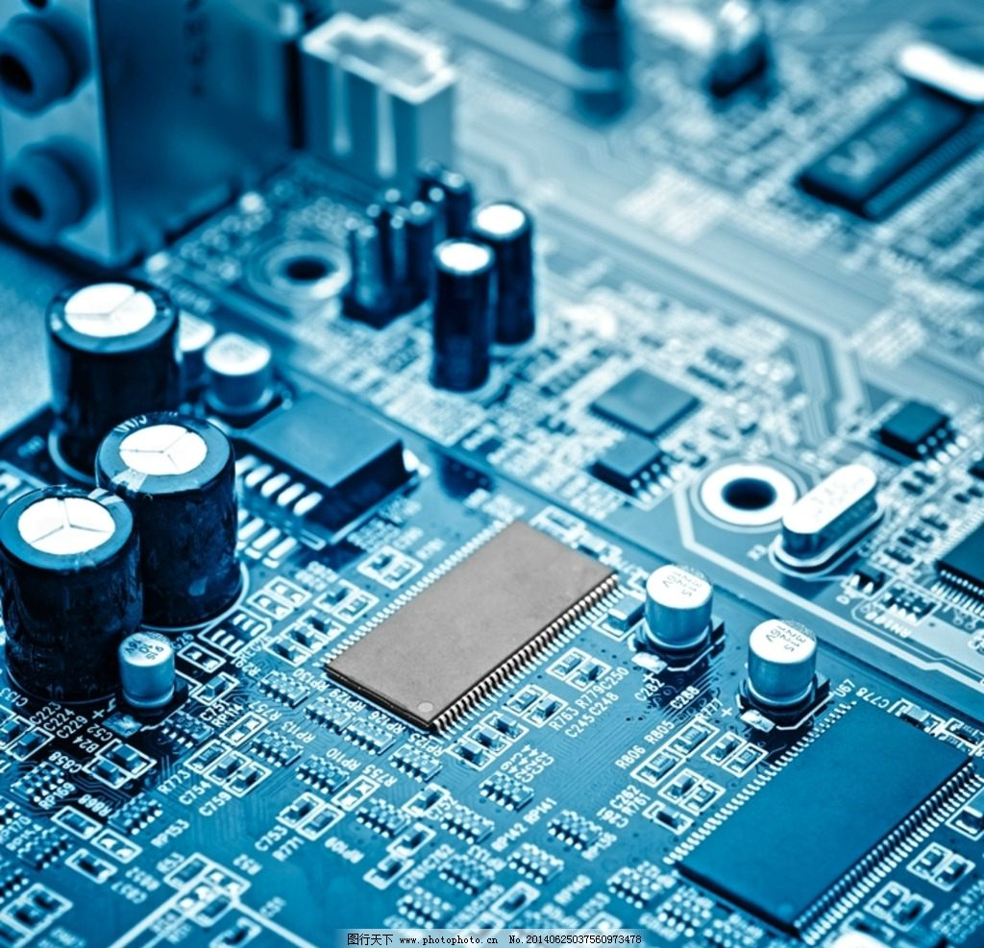
Some historians of technology have argued that the transistor, first crafted at Bell Labs in late 1947, is the most important invention in human history. Whether that's true or not, what is without question is that the transistor helped trigger a revolution that digitized the world.
晶体管于1947年底在贝尔实验室首次被制造出来。一些科技史学家认为，晶体管是人类历史上最重要的发明。不管这是真是假，毫无疑问的是，晶体管引发了一场世界数字化的革命。

Slide 9
A transistor is, to put it simply, a device that can switch an electric current on or off. Additionally, a transistor can boost current passing through it. Those abilities are fundamental for building all sorts of electronics, computers included. These powers were recognized when three Bell Labs scientists who built that first transistor won the 1956 Nobel Prize in Physics.
简单地说，晶体管是一种能接通或切断电流的装置。此外，晶体管可以放大通过它的电流。这些能力是制造包括计算机在内的各种电子产品的基础。1956年，贝尔实验室三位制造出第一个晶体管的科学家获得了诺贝尔物理学奖，晶体管的这些功能也得到了认可。

Slide 10
Transistors are typically made from certain elements called semiconductors, which are useful for manipulating current. The first transistor was fashioned from a metalloid, germanium. By the mid-1960s, most transistors were being made from silicon, and engineers were packing transistors together into complex integrated circuits: the foundation of computer chips.
晶体管通常由某些被称为半导体的材料制成，这些材料对控制电流很有用。第一个晶体管是用类金属锗制成的。到上世纪60年代中期，大多数晶体管都是由硅制成的，工程师们将晶体管打包成复杂的集成电路：这是计算机芯片的基础。

Slide 11
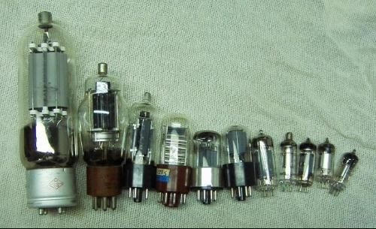
Before its dominance, electronics relied on vacuum tubes. Vacuum tubes have a few advantages over transistors. They could generate more power. But vacuum tubes are very bulky and delicate. The transistor seemed to be a convenient replacement.
在晶体管占据主导地位之前，电子产品依赖于真空管。与晶体管相比，真空管有一些优点。它们可以产生更多的能量。但是真空管非常笨重，而且易碎。晶体管似乎是一种方便的替代品。

Slide 12
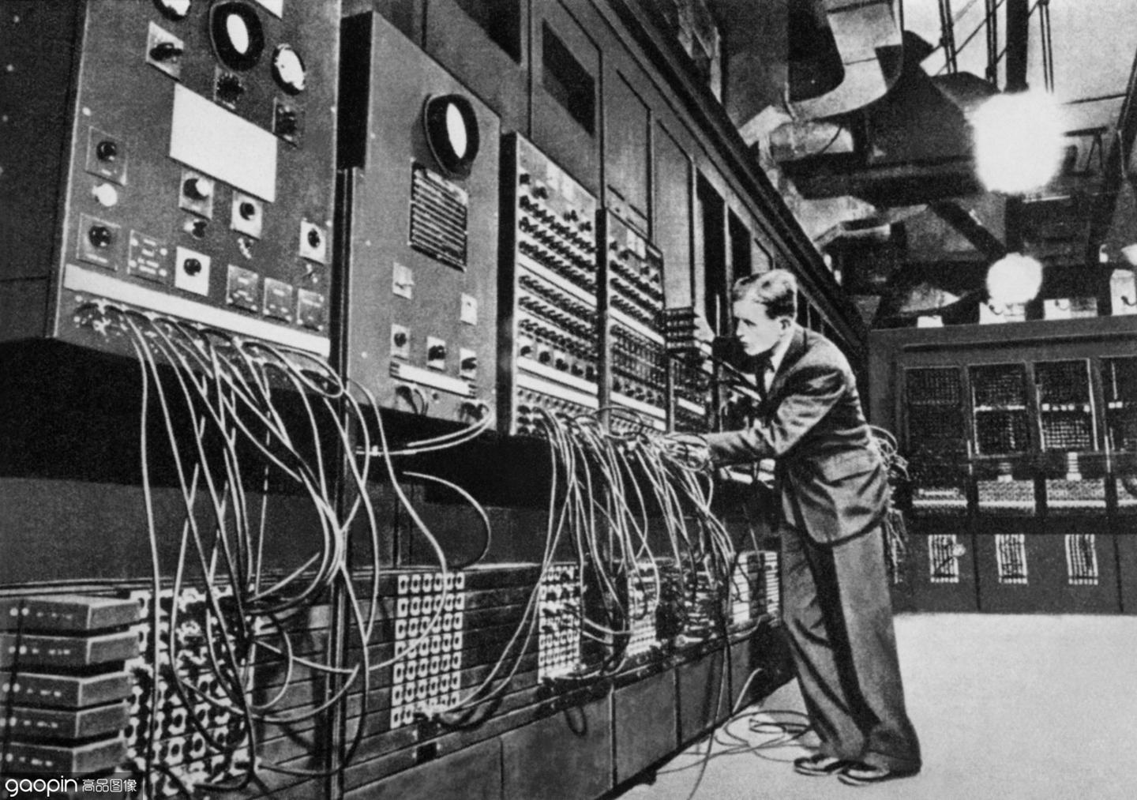
A computer built just before the start of the transistor era — ENIAC — used 18,000 vacuum tubes and filled up a space the size of a ballroom. Vacuum tube computers squeezed into smaller rooms over time. Even then, 1951's UNIVACI cost over a million dollars, and its customers were large businesses or data-heavy government agencies. It wouldn't be until the 1970s and 1980s when personal computers, powered by transistors, started to enter middle-class homes.
一台在晶体管时代开始前制造的计算机——ENIAC——使用了18000个真空管，占据了一个舞厅大小的空间。随着时间的推移，真空管计算机也挤进了更小的房间。即使在那时，1951年的UNIVACI耗资超过100万美元，其客户是大企业或数据量大的政府机构。直到上世纪七八十年代，由晶体管驱动的个人电脑才开始进入中产阶级家庭。

Slide 13
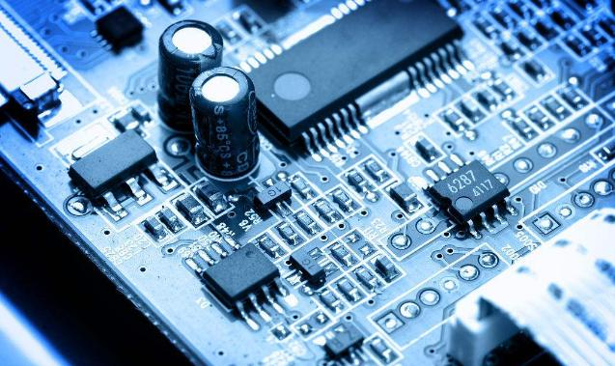
Without transistors, we might live in a world where a computer is something you'd use at work — not at home. Forget smartphones, handheld navigation, flatscreen displays, electronic timing screens in train stations, or even humble digital watches.
如果没有晶体管，我们可能会生活在一个电脑只在工作场所使用而不是在家里使用的世界。更别提智能手机、手持导航、平板显示器、火车站的电子计时屏幕，甚至是不起眼的电子表了。

Slide 14
"The transistor is fundamental for all modern technology, including telecommunications, data communications, aviation, and audio and video recording equipment," says Ravi Todi, current president of the IEEE Electron Devices Society.
电气与电子工程师协会（IEEE）电子设备学会现任主席拉维·托迪（Ravi Todi）说，“晶体管是所有现代技术的基础，包括电信、数据通信、航空以及音频和视频录制设备。”

Slide 15
谢谢观看
Thanks for watching
汇报人：任广轶
时间：2023年5月31日

